Slide 1
Pokerbots 2022
Lecture 3: Game Theory

Slide 2
Weekly Tournament:
Tomorrow @ 11:59pm EST

Slide 3
Games and Giveaways

Slide 4
First game
Submit an integer between 0-1000 inclusive
Winner is the closest guess to 2/3 of the average submission (a tie is broken randomly)
Prize: today’s giveaway
pkr.bot/beauty

Slide 5
Second game
Entry fee: 0 ELO points
Parse the last 4 digits of your MIT ID as an integer 0-9999
Winner is the highest integer (a tie is broken randomly)
Prize: 1 pokerbots sticker!
pkr.bot/lemons

Slide 6
Resume Raffle!
Link: pkr.bot/drop

Slide 7
Agenda
What is a game?
Pure and mixed strategies
Nash equilibria
Applications to poker

Slide 8
What is a game?

Slide 9
Definition
We generally only consider two-player zero-sum games; we will refer to these as simply games.
Examples: RPS, tic-tac-toe, (chess? poker??)
Notes:
Discuss what the terms mean (2-person and zero-sum). Note that “game” means a broader thing and we are just using shorthand.
Examples: rocks paper scissors, pick the bigger number, chess/poker [will flesh out later].
Rocks paper scissors will be guiding example through a lot of this first part

Slide 10
Formalized
A game between players 1 and 2 consists of a pair of strategy sets S₁ and S₂, and a utility function u : S₁ x S₂ ⟶ R. Players submit strategies simultaneously. Player 1 seeks to maximize u, and player 2 seeks to minimize u.
Think of utility as chips. This means players want to submit actions that have the highest payout.
Player 2 is minimizing since we're talking about zero-sum games.

Slide 11
Pure and mixed strategies

Slide 12
Pure and mixed strategies
There are only 3 pure strategies in RPS, but infinitely many mixed strategies
A mixed strategy is described by a probability distribution over pure strategies:
Example:
P(rock) = 0.4
P(paper) = 0.3
P(scissors) = 0.3
Mixed strategies show us the power of randomness
Notes:
Discuss what this even means
What are mixed strategies in MNIBTY? [ask class]

Slide 13
Matrix form games
Suppose the strategy sets S₁ and S₂ consist of probability distributions over a finite list of pure strategies. Also, suppose that the utility function is linear. Then, we can write our game in matrix form, with utility function shown.
 | Rock | Paper | Scissors
Rock | 0 | -1 | +1
Paper | +1 | 0 | -1
Scissors | -1 | +1 | 0
Notes:
RPS is a symmetric game

Slide 14
Revisiting the first game
Notes:
Give stats (%0, average, ⅔ average, winner)

Slide 15
The Keynesian beauty contest
No rational player would play above 2/3 · 1000 = 667
Hence, no rational player would play above 2/3 · 667 = 445
What happens if we continue this logic?
What would "rational" players play?
Notes:
A note on theory vs practice! blotto

Slide 16
Dominance
We say that strategy A dominates strategy B if playing A is always a better idea
u(A, O) ≥ u(B, O) for all player 2 strategies O
Second-order dominance: replace “is always a better idea” with “is always a better idea, if our opponent does not play dominated strategies”
Notes:
Replace better with “at least as good”
Note that there are edge cases where strategy A is not dominated by strategies B or C, but is dominated by some mixed strategy in B and C.
No dominance in RPS

Slide 17
Dominance Example
What does this mean?
 | C (c) | D (d)
A (a) | (+3, -3) | (+2, -2)
B (b) | (+1, -1) | (-1, 1)
 | C (c) | D (d)
A (a) | (+3, -3) | (+2, -2)
B (b) | (+1, -1) | (-1, 1)
 | C (c) | D (d)
A (a) | (+3, -3) | (+2, -2)
B (b) | (+1, -1) | (-1, 1)
 | C (c) | D (d)
A (a) | (+3, -3) | (+2, -2)
B (b) | (+1, -1) | (-1, 1)

Slide 18
Nash equilibria

Slide 19
An equilibrium is a set of strategies, one for each player, such that nobody has an incentive to switch.

Slide 20
Nash equilibrium examples
0 is an equilibrium for the Keynesian beauty contest
1/3 rock, 1/3 paper, 1/3 scissors is an equilibrium for RPS
Notes:
Talk about how there is a pure strategy equilibrium for beauty contest, but what about RPS and MNIBTY?

Slide 21
Solving the equilibrium for RPS
r + p + s = 1; r, p, s ≥ 0
Expected value of opponent playing each case
Solve p - s = s - r = r - p to get r = p = s = 1/3. This guarantees us at least 0
 | Rock (r) | Paper (p) | Scissors (s)
Rock (r) | 0 | -1 | +1
Paper (p) | +1 | 0 | -1
Scissors (s) | -1 | +1 | 0
EV | Opponent | p-s | s-r | r-p
Notes:
r,p,s are our probabilities of playing rocks paper and scissor

Slide 22
Why p - s = s - r = r - p?
Suppose opponent plays the optimal counterstrategy against our r, p, s strategy
Opponent minimizes the utility function amongst their three options:
min_{args}(p - s, s - r, r - p)
We play the strategy that maximizes the utility function even against the optimal counterstrategy:
max_{r, p, s}(min_{args}(p - s, s - r, r - p))

Slide 23
Asymmetric game
Toy game for illustration: I am choosing battle plans against the enemy
We notice two things: the game isn't symmetric, and that we see a lot of positive values.
 | Full Defense | Defend in shifts
Charge | 0 | +3
Sneak attack | +1 | -1
Notes:
This game is themed around military battle plans, because game theory was actually developed significantly by military strategists at the RAND Corporation, a large think tank, during the 1950s!
Notes on this method: it’ll give you garbage if dominated strategies are in there. “Can always do this” via LP duality

Slide 24
Asymmetric game mixed strategy equilibrium
Setting this up, we start with c + s = 1; c, s ≥ 0
Solving, we get c = 0.4, s = 0.6, f = 0.8, d = 0.2
“Value” of the game to us is 0.6
 | Full Defense (f) | Defend in shifts (d) | EV | Opponent
Charge (c) | 0 | +3 | 3d
Sneak attack (s) | +1 | -1 | f-d
EV | Opponent | s | 3c-s | :)

Slide 25
Existence of Nash equilibria
Theorem (Nash, 1951): Every finite game has a Nash equilibrium in mixed strategies.
Proof: Topology (uses fixed point theorem).
Notes:
Fixed point theorem

Slide 26
Applications to poker

Slide 27
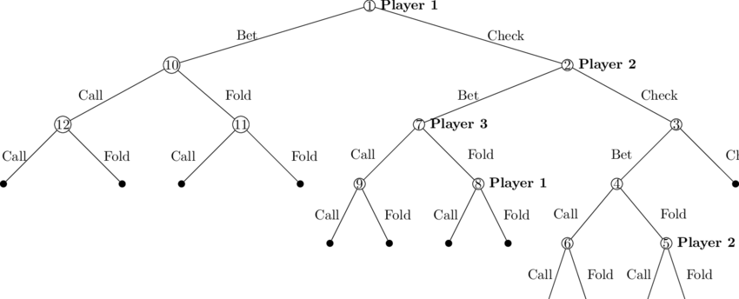
Game Tree

Slide 28
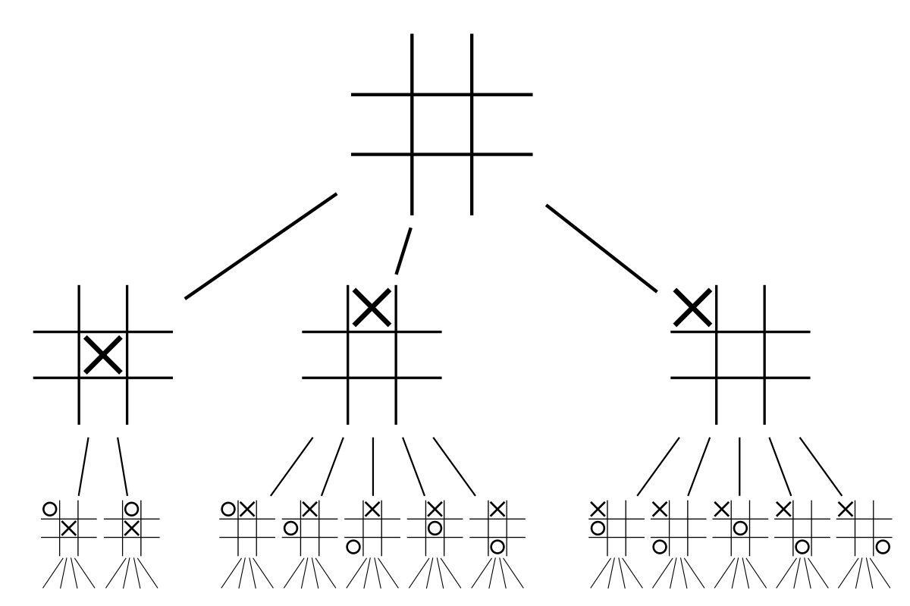
Extensive form games
Notes:
How to deal with sequential games?
Discuss chess, backwards induction
Define extensive form

Slide 29
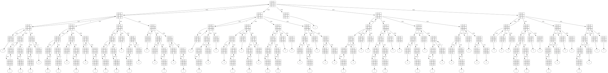
Tic Tac Toe Full Extensive Form

Slide 30
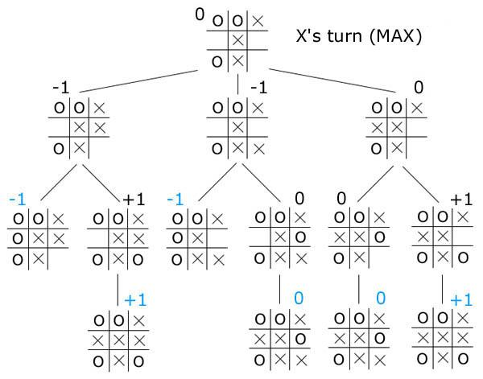
Backwards induction
Black are the determined payouts based on players acting rationally
Blue are the leaves - the terminal states of the game
Follow the game tree up (backwards) to find the state's value
Notes:
How to deal with sequential games?
Discuss chess, backwards induction
Define extensive form

Slide 31
Backwards induction
Looking at the leaf states first, I see -1s in the left 2 branches, leaving their parents as -1.
The rightmost branch has payouts 0 and 1. Following this up the tree, we get 0 for the black value.
Finally, all together X should try to play for 0 (tie), and does so by putting x in left center.

Slide 32
Conversion to normal form
Every extensive form is also a normal form (matrix) game
Notes:
Problem: exponential blowup! Actually it’s worse than that, because the game tree is ALREADY exponentially large.

Slide 33
Conversion to normal form
Every extensive form is also a normal form (matrix) game
Mapping: each pure strategy (row/column) is a complete set of instructions for what to do at each node
Example: in poker, each pure strategy would be a dictionary which maps the game_state to a unique action
Notes:
Problem: exponential blowup! Actually it’s worse than that, because the game tree is ALREADY exponentially large.

Slide 34
Implications
Poker has a Nash equilibrium - it's a finite game that satisfies the conditions
Can we use backwards induction to solve for it? Can we still use the same type of game tree?
How is poker different from tic-tac-toe? RPS? Chess?

Slide 35
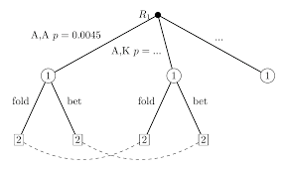
Adding in imperfect information and randomness
Notes:
Same idea, except now we collapse some of the nodes from the perspective of one of the players.

Slide 36
Imperfect Information and Randomness
Randomness: Don't know where in the game tree you're moving next
Imperfect: Don't know what node you're currently at since your opponent's hole cards are hidden (information sets)
Together, this leads to a really nice property of poker. The general game tree movements (bet/fold/call) are known, but the definite game state isn't. Imperfect information makes games fun!

Slide 37
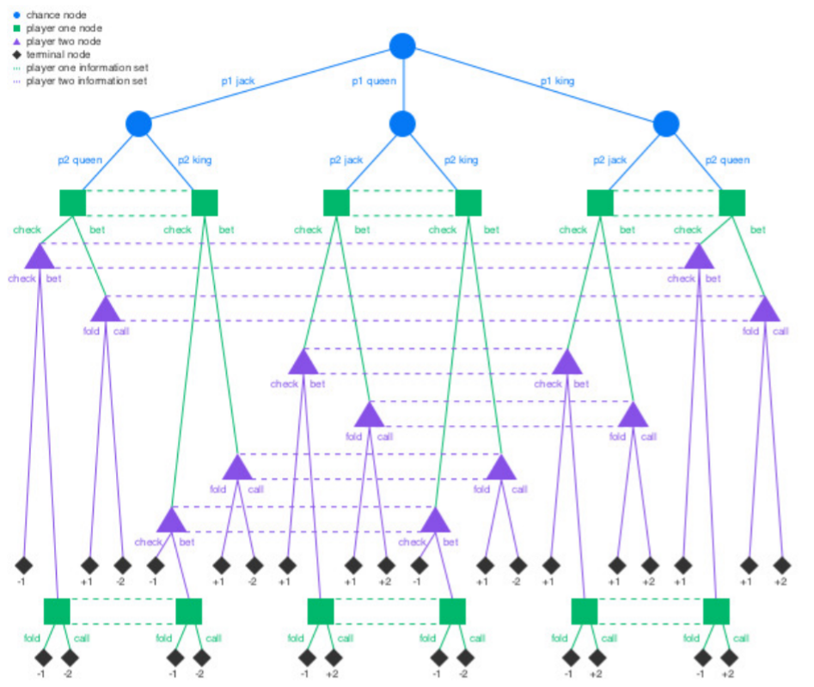
Kuhn Poker Game Tree

Slide 38
Poker Nash equilibrium and use
Poker has a Nash equilibrium that has EV 0
The matrix is doubly exponential in size - incomputable
Does “play good poker” reduce to “play the equilibrium strategy”?
Exploitative strategies as alternatives
Notes:
Talk about tractability, approximation methods, and what we mean by quasi-uniqueness (zero sum games).
In practice, Nash should defeat things not in the support of the Nash. but this is more of an empirical truth [Libratus], mention RPS. Certainly an exploiter can outperform a Nasher in this tourney.

Slide 39
Applied game theory
Notes:
https://www.youtube.com/watch?v=hRIXXCe0Hi0

Slide 40
Revisiting the second game
Notes:
Give stats (how many played, min/max/average player, winner)

Slide 41
The MIT ID game
Suppose rational players would only play if their number is ≥X
Students might submit only if ≥9000
But if only ≥X is submitted, then X is the smallest value and shouldn't be submitted
Why submit 9000?
Continue this logic (nth order dominance)
Why submit 9001? 9002?
Notes:
A note on theory vs practice!

Slide 42
Adverse selection
Occurs anytime “buyer” and “seller” have asymmetric information
Market for cars: suppose there are used cars with private value distributed uniformly between $1000 and $10000. What should the market price be?
What would car owners do? Then what happens?
Notes:
Occurs all the time in finance. Used cars example. Econ $20 bill joke.

Slide 43
Sources of adverse selection in poker
First action when betting (differential check to the preflop aggressor)
Multiple bets in a row (what types of hands do this?)
Being in the later stages of the round (why would are they still in the pot?)
Others?
Notes:
Ask for audience here/
Literally just being in the game at the flop, etc

Slide 44
When I bet, am I happy with my bet conditioned on my opponent calling?

Slide 45
Adverse selection and determinism
Suppose I have the following deterministic betting strategy:
All-in when I have a top X% hand
How can my opponent exploit me?

Slide 46
Coding Reference-3 Bot
Notes:
https://www.youtube.com/watch?v=hRIXXCe0Hi0

Slide 47
Beauty Contest Winner

